Slide 1
COMP 202 CSUS Review
Ginika Ume-Onyido & Imad Dodin

Slide 2
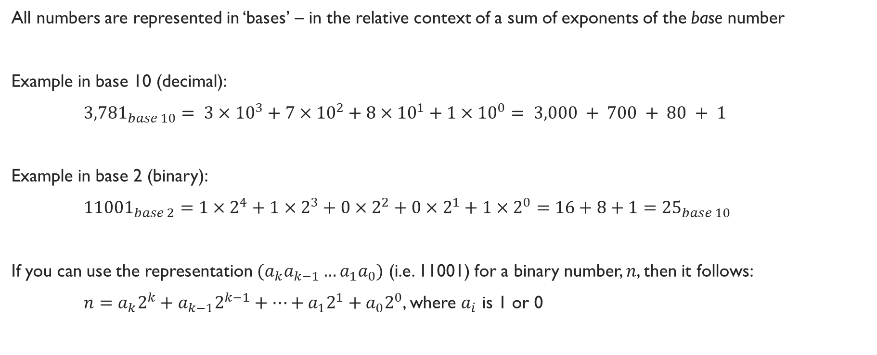
Number bases and Binary
All numbers are represented in ‘bases’ – in the relative context of a sum of exponents of the base number
Example in base 10 (decimal):
${3,781}_{base 10}= 3×{10}^{3}+7×{10}^{2}+8×{10}^{1}+1×{10}^{0}= 3,000 + 700 + 80 + 1$
Example in base 2 (binary):
${11001}_{base 2}=1×2^{4}+1×2^{3}+0×2^{2}+0×2^{1}+1×2^{0}=16+8+1={25}_{base 10}$
If you can use the representation $(a_{k}a_{k−1}…a_{1}a_{0})$ (i.e. 11001) for a binary number, $n$, then it follows:
$n=a_{k}2^{k}+a_{k−1}2^{k−1}+…+a_{1}2^{1}+a_{0}2^{0}$, where $a_{i}$ is 1 or 0

Slide 3
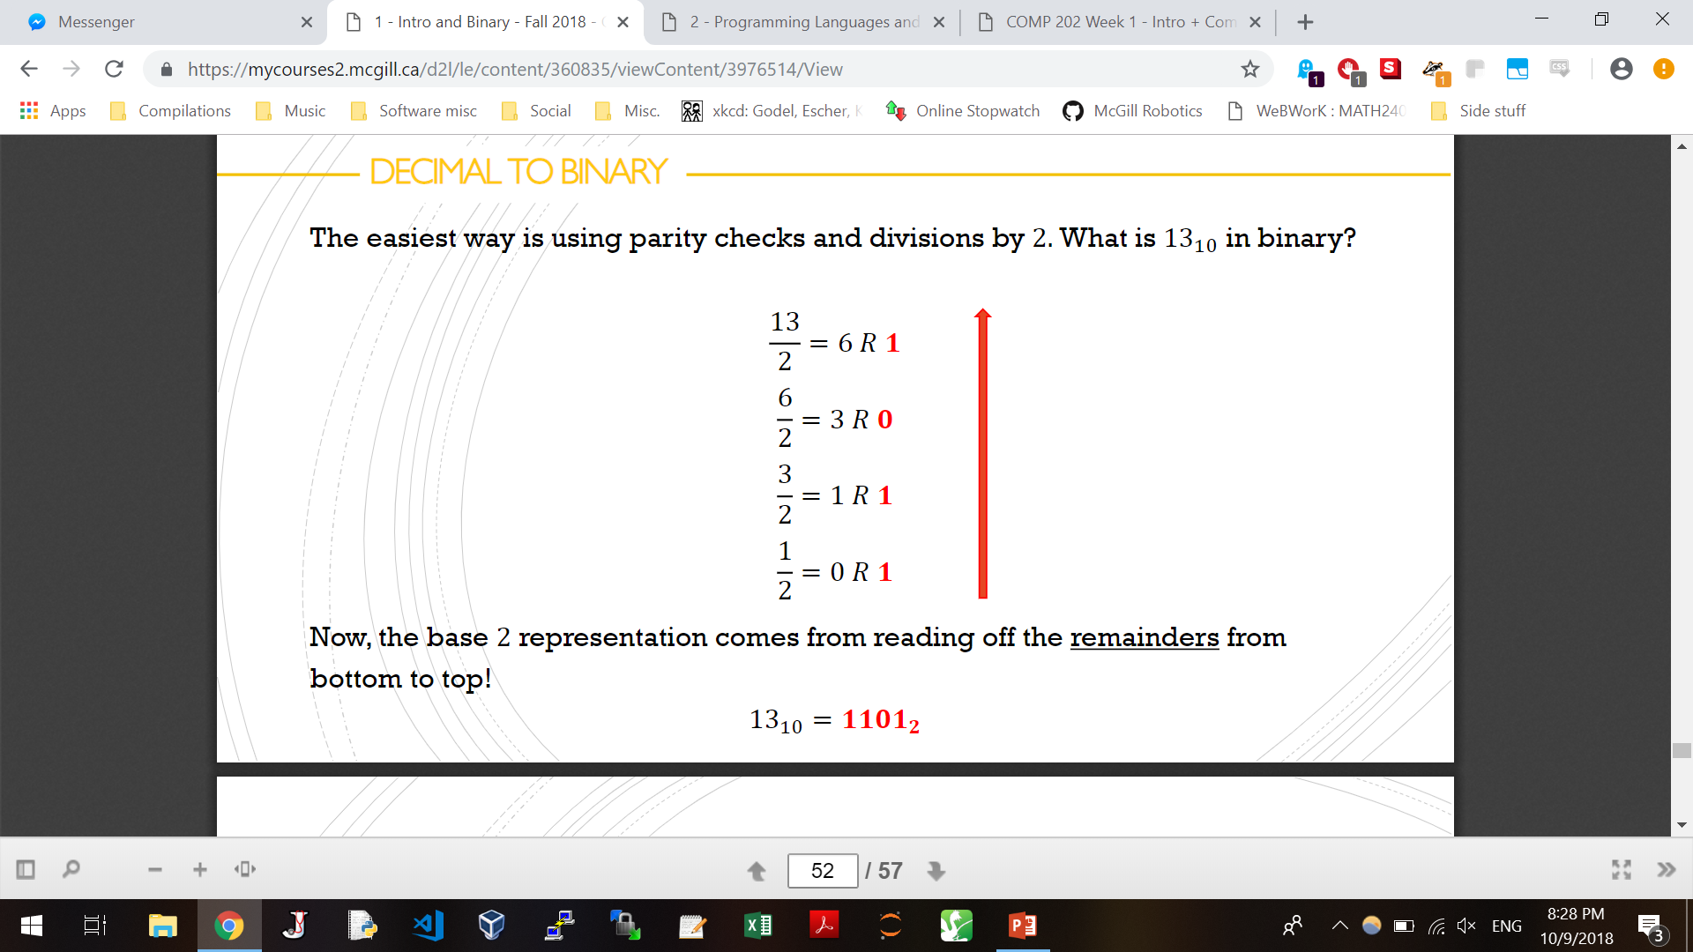
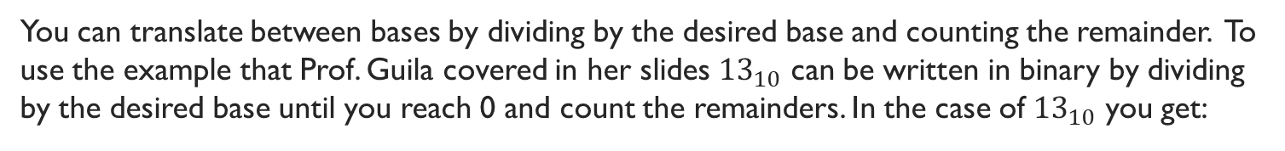
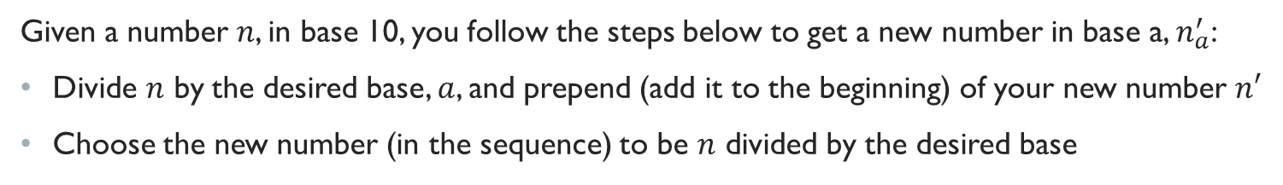
Number bases and Binary
You can translate between bases by dividing by the desired base and counting the remainder. To use the example that Prof. Guila covered in her slides ${13}_{10}$ can be written in binary by dividing by the desired base until you reach 0 and count the remainders. In the case of ${13}_{10}$ you get:
Given a number $n$, in base 10, you follow the steps below to get a new number in base a, $n_{a}^{′}$:
Divide $n$ by the desired base, $a$, and prepend (add it to the beginning) of your new number $n′$
Choose the new number (in the sequence) to be $n$ divided by the desired base

Slide 4
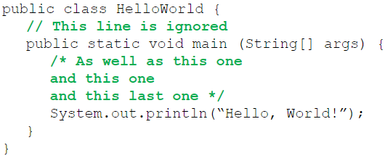
Programming Languages
To begin, looking at Java as a programming language lets look at the age-old Hello World program:
There are many small (syntactical) things going on in the above clip:
Programming syntax: curly braces, semi-colons, comments etc.
Return types (String, void, main, int etc.)
Public
Methods & Classes
Packages

Slide 5
Programming Languages
Code can be:
A code block (in a meta sense) that contains code in curly braces
A statement – a line of code that ends in a semi-colon and is executed
A comment
To make sure your code follows best practice(i.e. is readable and clean) you should:
Have a line after: opening/closing a curly brace or finish typing a statement with a semi-colon
Indent all the code that exists inside a block
Use variable names that relate to their purpose

Slide 6
Variables, primitive Data & Arithmetic Operations
Definition:
A variable, as Prof Guila describes, is a “named location that stores a value”; a location is an address in the memory of the computer and a value is some specific value of a data type (boolean, String, int etc.)
Variables have identity as defined by their:
Name
Used to lookup the variable in memory (and make code more readable overall) – try to use descriptive names in camelCase
Type
Describes what kind of value we are storing / how we should look at it
Interestingly, the ‘space in memory’ that a specific data type takes up is reflected by the data type itself

Slide 7
Variables, primitive Data & Arithmetic Operations
There are 3 ‘steps’ to a variable’s life:
Declaration
When you declare a variable you describe its identity to the computer (name and type)
Initialization
Intuitively, a variable must be initialized (given an initial value) before they can be used
Manipulation & Assignment
When you assign a value to a variable you use the assignment operator ‘ = ’ and Java will update the variable (on the left of the operator) to contain the value that the expression (on the right of the operator) evaluates to
Note: only variables can be assigned expressions, the following is NOT legal 3 = x - y
Notes:
Cover / point out the idea that types (among other things) are reserved keywords in Java – and what that means
Perhaps test their understanding with some code lines, try to do some expressions where variables are used and reassigned repeatedly to see if they follow along

Slide 8
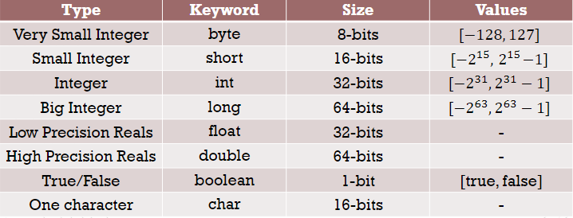
Variables, primitive Data & Arithmetic Operations
Two types of data types:
Primitive type – there are 8 primitive data types:
bye, short, int, long, float, double, Boolean, char
Reference type – anything defined by a class:
String…
Different types of data are designed to be used in different circumstances:
Notes:
Discuss overflow and going over the limit, i.e. if you go over $2^{31}−1$ for an int etc.
Also the way in which syntactically 3 and 3.0 denote two different things
I feel like casting (up and down) would be good to cover here too

Slide 9
Variables, primitive Data & Arithmetic Operations
Standard mathematical operators:
Addition, +
Subtraction, -
Multiplication, *
Division, /
Modulo, %
Like in ‘regular’ arithmetic, when Java compiles (and runs) it executes expressions in the following priority:
Parenthesis
Multiplication, Division and Modulo
Addition, Subtraction
Notes:
Besides ‘regular’ maths, Guila goes over binary arithmetic too, maybe go over an example or two?
I would explain the operation-assignments: *=, +=, -=, /=
Increment, decrement too: x--, --x, x++ & ++x

Slide 10
Variables, primitive Data & Arithmetic Operations
There’s an incredibly useful package in Java: the math library ‘Math’. Some useful methods and constants are:
Math.abs(x)
Math.sqrt(x)
Math.pow(x, y)
Math.sin(x)
Math.random()
Math.E
Math.PI
…and many, many more!
Notes:
The professor uses an example with triangles and the like to go into the Math library in more detail – maybe something like that would be useful?

Slide 11
Variables, primitive Data & Arithmetic Operations
Strings are used to store ‘phrases’ in Java and String values must start and end with double quotes – “ ”. You can use the additional operator to concatenate (to join) strings together but if you want to cast from int/double to String you need to use:
Integer.parseInt(String phrase)
Double.parseDouble(String phrase)
Notes:
Maybe wrap up with a mini-demo or a quiz?

Slide 12
Expressions, command line args and random numbers
An expression, in an abstract sense, represents a sentence in Java that needs/will be computed down to a single value (with its associated type!) by:
Making any method calls described
Substituting variables with the values they contain
Finishing any arithmetic they’re involved in
Loop 1 - 3 until a final result is calculated
Note that Java, as a language, will be strict with you about the types that you give it. If a method call returns a value, you must store that value only in a variable that (at least weakly) matches its type:
String s = System.out.println(“Hello”); > Illegal as the return type of the library call isn’t a String
Double d = Math.pow(4, 5) + 3; > Legal (but not clean), it should be + 3.0

Slide 13
Expressions, command line args and random numbers
The final thing we see in the declaration of the main method represents something called command line arguments:
public static void main ( String[] args )
These are a list of strings that you can pass to your program when you run it that allows the person who runs the program to interact / provide information instead of just the programmer:
> run SampleProgram word1 word2 word 3
The above strings – “word1” “word2” and “word3” – can be accessed in our program with args[0], args[1] and args[2].
Note: Its important to realize that Java will split up the arguments you provide by spaces so
> run SampleProgram My name is Ginika
Will have args[0] = “My”, args[1] = “name” etc.
Notes:
I think a demo here to do something simple like print things in reverse order or do some addition might be useful if the class wants

Slide 14
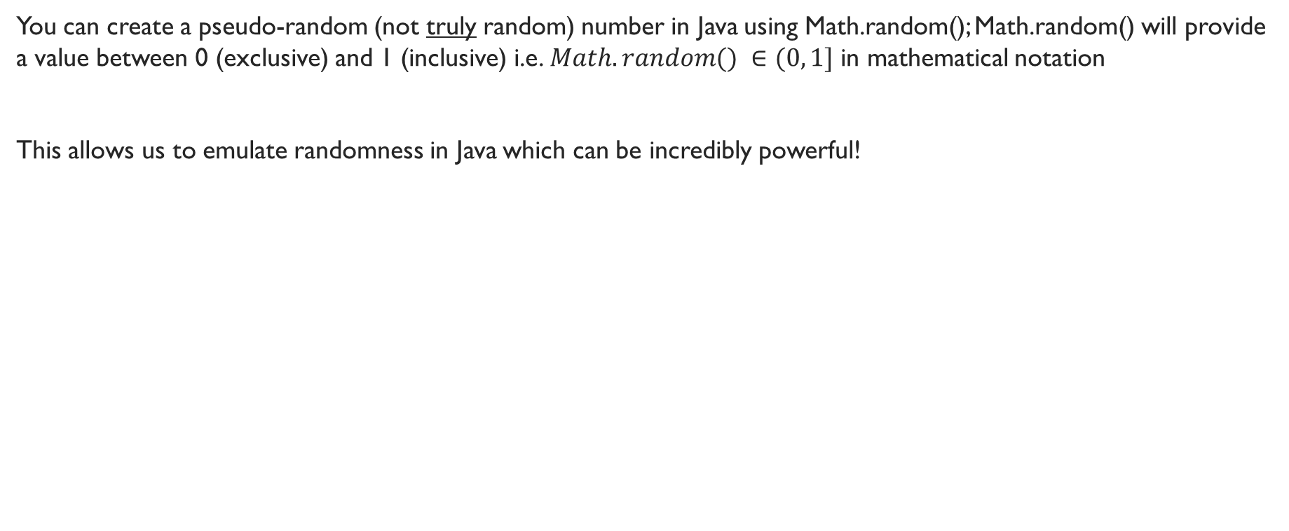
Expressions, command line args and random numbers
You can create a pseudo-random (not truly random) number in Java using Math.random(); Math.random() will provide a value between 0 (exclusive) and 1 (inclusive) i.e. $Math.random() ∈(0, 1]$ in mathematical notation
This allows us to emulate randomness in Java which can be incredibly powerful!

Slide 15
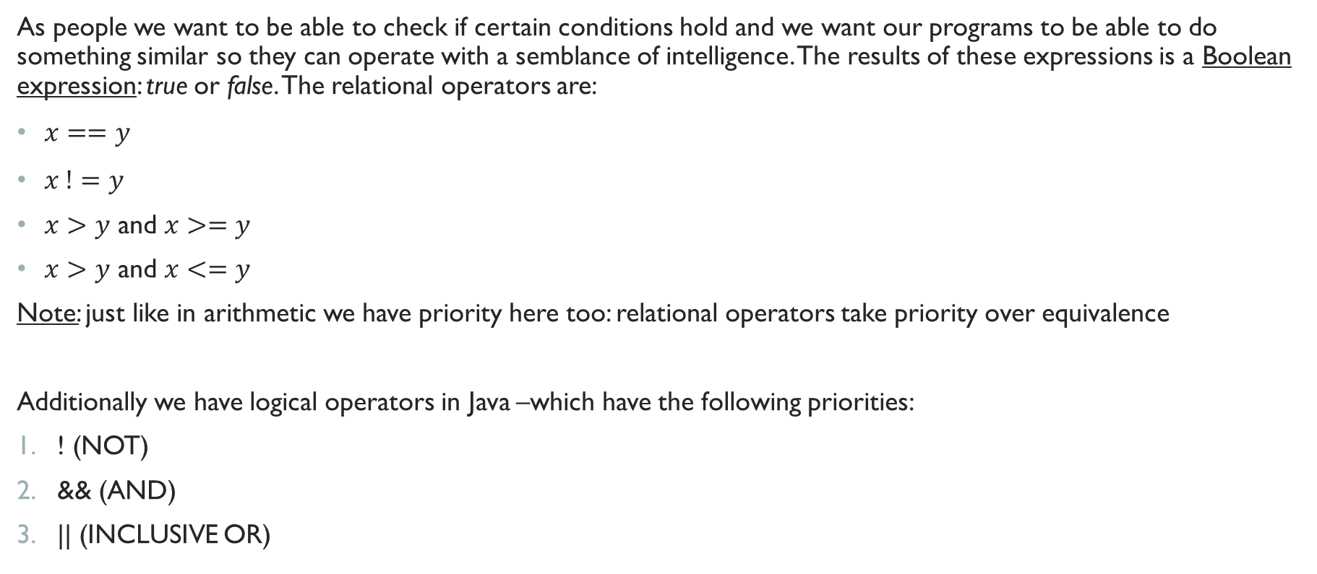
Relational and Logical operations, Conditional Statements
As people we want to be able to check if certain conditions hold and we want our programs to be able to do something similar so they can operate with a semblance of intelligence. The results of these expressions is a Boolean expression: true or false. The relational operators are:
$x==y$
$x !=y$
$x>y$ and $x>=y$
$x>y$ and $x<=y$
Note: just like in arithmetic we have priority here too: relational operators take priority over equivalence
Additionally we have logical operators in Java –which have the following priorities:
! (NOT)
&& (AND)
|| (INCLUSIVE OR)

Slide 16
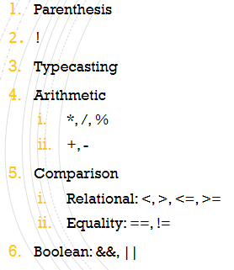
Relational and Logical operations, Conditional Statements
Overall the order of operations are:
Notes:
Maybe do some quick Boolean tests to see if this all makes sense

Slide 17
Relational and Logical operations, Conditional Statements
Conditional statements give a programmer real power in their programs as you can execute different sections of your code. They follow the following structure:
if ( COND EXPR 1 ) {
// Execute if EXPR 1 was true
}
Else if (COND EXPR 2 ) {
// Execute if EXPR 1 was false and 2 is true
}
…
Else {
// Execute if all expressions were false
}
Notes:
I would really recommend doing some examples for this. A common midterm question is to check something like
If …
If …
Else …
To see if they understand that the else only ‘connects’ to the last if statement

Slide 18
Void methods
A method is a named block of code that performs a particular task – as described in that block of code specifically. All methods must be inside a class and, therefore, a class can contain anywhere from 0 to n many methods.
Note: it is considered best-practice to have the main method as either the first or last method in a class
A method can take {0…n} many inputs and either return a value or not – these are called Value and Void Methods respectively. We need to describe all of this (the number of parameters, return type etc.) when we declare a method:
public static returnType methodName( inputType1 var1, … , inputTypeN varN ) {
// Code
}
In general methods are used to eliminate repetitive work and to compartmentalize tasks so that they can be more cleanly designed and executed.
Notes:
I’ve tried to color-code these to make it more obvious how/why they would relate

Slide 19
Void methods
The tricky thing is that the flow of execution is not always as simple as we’d like it to be:
Execution begins at the first statement in the current method (at the beginning this is the main method)
Statements are then executed one at a time (after that first statement)
If a call to a method is reached then the program takes a detour to repeat steps 1 and 2 until the method is finished before returning to the method that called it
The above is continued until there is nothing left to execute in the main method and the program closes (exits)
Notes:
I think a simple example/demo of nested calls to check their understanding would be good here

Slide 20
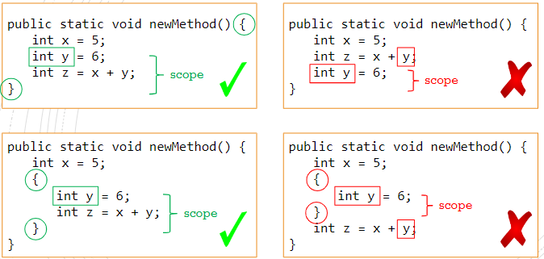
Void methods
Scope is the idea that a variable should exist in a localized area, specific to the area of code where it was declared. This means that it does NOT exist in other methods or conditional blocks – even if something with the same name exists in another area it won’t be the same variable). So:
“A variable will therefore start to exist in the block (method or condition block) in which it was declared in and cease to exist at the closing curly brace which closes the most recent open curly brace (in which the variable was declared)”

Slide 21
Value methods and chars
The return statement is a powerful tool for you to terminate the execution of a method while ‘passing’ on some information to whoever called the method the return statement is in. This is the fundamental difference between value and void methods, value methods:
Declare the type that they will later return
Use (at least) one return statement to provide a return value
public static int methodName( … ) {
// Code
return 3;
// Possibly unreachable code
}
Note: be careful you don’t create ‘dead’ code by writing code that cannot be reached (due to a return) – this can be done with conditional statements
Notes:
I think a quick demo or two would be good here, just 3-5 lines on a board or something to check their knowledge

Slide 22
Value methods and chars
Java allows you to overload methods: it lets you define methods with the same name but different parameters. This can be really useful when you have several different ways of trying to do something. Lets say we want to make a triangle, there are a few ways:
An equilateral triangle takes one double as an input
An isosceles triangle takes two doubles as inputs
A scalene triangle takes three doubles as inputs
This can actually be incredible powerful as you can create a whole system of methods to handle a situation with a fine-tooth comb
Notes:
I think a quick demo or two would be good here, just 3-5 lines on a board or something to check their knowledge

Slide 23
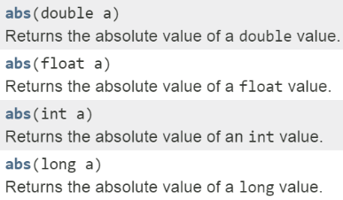
Value methods and chars
An example of an overloaded method is in the Math library:

Slide 24
Value methods and chars
Because of its size and use in computer science at large, the data type char has a few extra bells and whistles attached to it. Unlike Strings character literals must be declared in single quotes and can only contain a single character
Note: important to note that escape characters are still counted as a single character because they represent a single concept / character – ‘\n’ is a single character in Java
Because characters can (and are) encoded mathematically in Java we can increment and compare them as such
This brings us to Unicode – the way in which characters are encoded by integers as we’ll see on the next slide!
Notes:
I think an example here of char maths would be good like ‘c’++ or something like taht

Slide 25
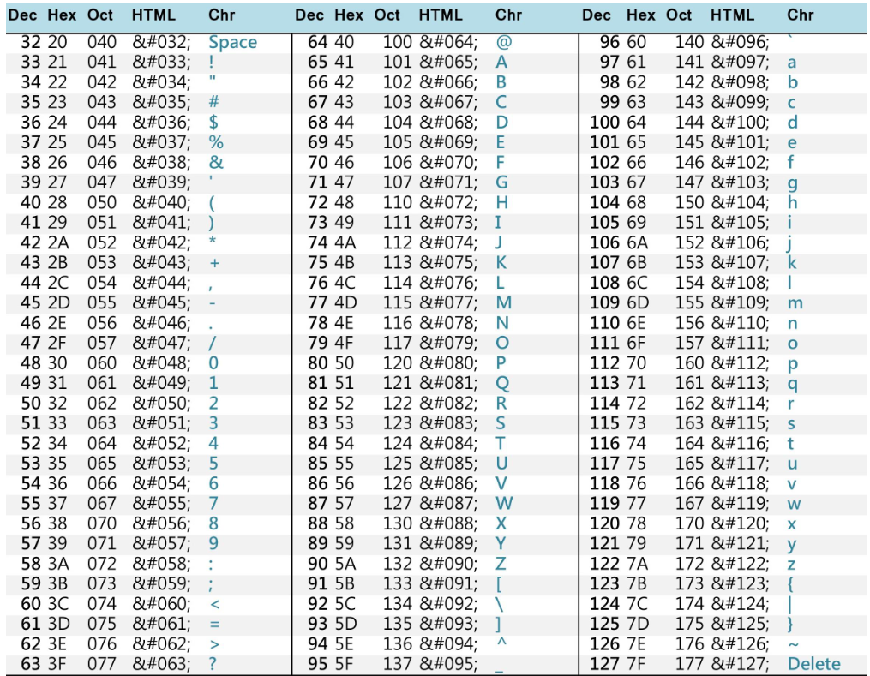
Value methods and chars

Slide 26
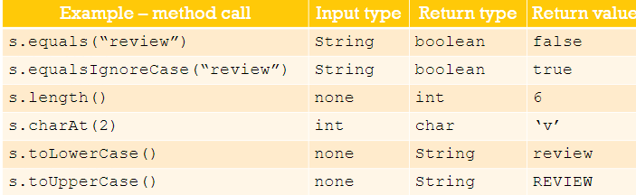
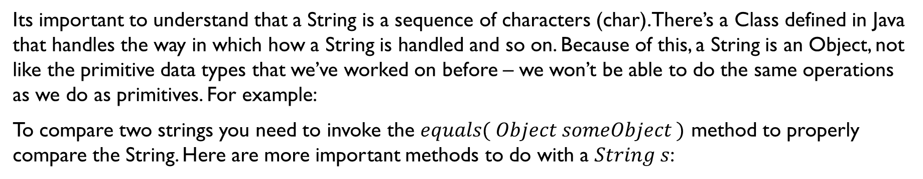
Strings and loops
Its important to understand that a String is a sequence of characters (char). There’s a Class defined in Java that handles the way in which how a String is handled and so on. Because of this, a String is an Object, not like the primitive data types that we’ve worked on before – we won’t be able to do the same operations as we do as primitives. For example:
To compare two strings you need to invoke the $equals( Object someObject )$ method to properly compare the String. Here are more important methods to do with a $String s$:

Slide 27
Strings and loops
A loop is a block of code which is detailed to execute in a repeated fashion under a specific condition. For instance, a simple analogy in English would be: “while it is raining outside, hold up my umbrella”. The syntax for a while loop is:
while ( CONDITION ) {
// Execute this code repeatedly
}
Its important to carefully construct these loops in a way that does not create an infinite loop – a block of code that is executed forever because the condition never changes ‘enough’ to break out of loop. For instance:
while ( x < 5 ) {
System.out.println(“hi”);
}

Slide 28
Strings and loops
There is another kind of loop: the for loop. A for loop is a while loop with a built-in ‘counter’ – a variable that is used to more accurately and precisely track the progress / state of the loop in question. Fundamentally, the two loops are equivalent except in how they handle their iterations – Professor Guila describes it well:
For loops should be used when the condition being checked depends on the value of an iterations and/or the number of iterations is fixed or easily computable
While loops should be used when the of iterations may be indefinite or somewhat unbounded
The syntax is as follows:
for ( statement; condition; statement ) {
// Some code that loops
}
Notes:
Maybe this is confusing or too much but maybe go over how the three pieces of a for loop are optional… technically?

Slide 29
Strings and loops
There are two statements unique to loops:
break – used to (unconditionally/immediately) exit the (localized) loop
continue – used to skip to the next iteration of the loop
Notes:
Again, I think a demo to wrap-up would be good here

Slide 30
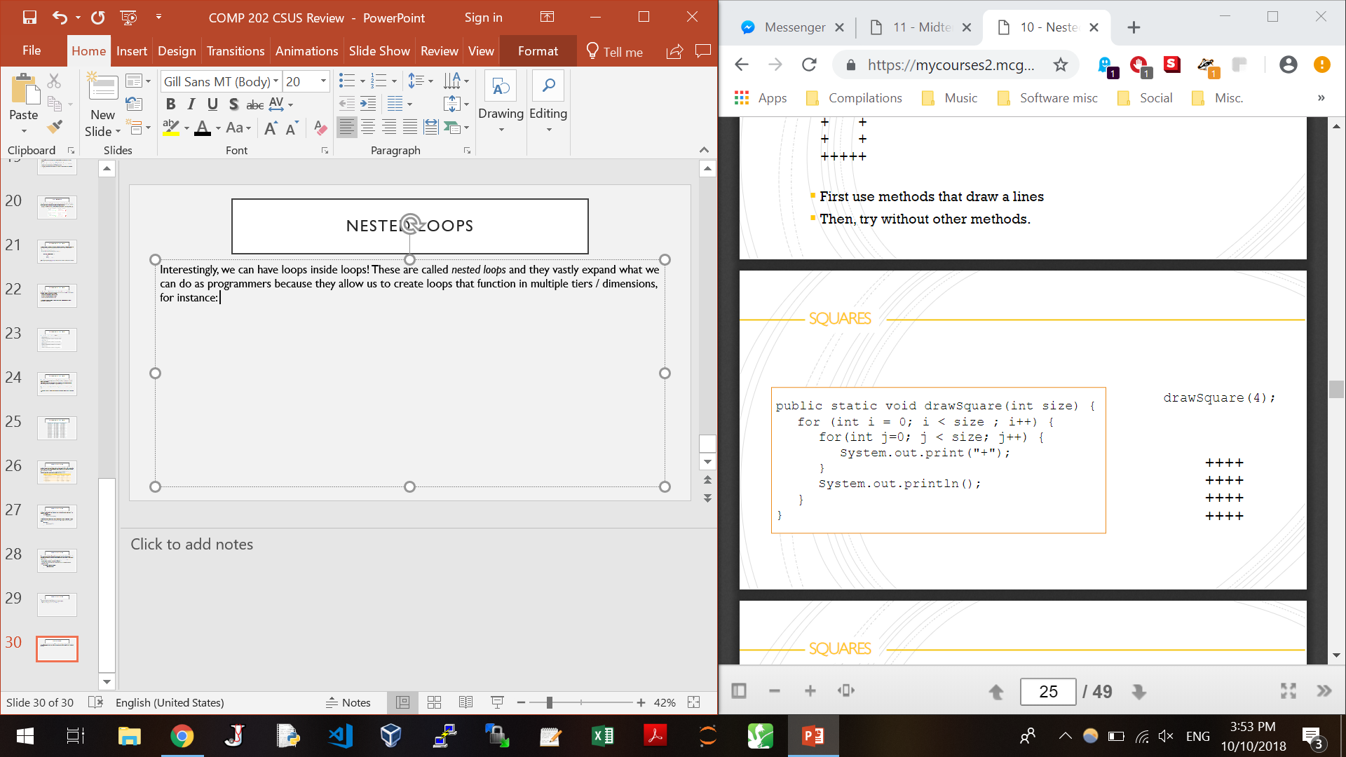
Nested loops
Interestingly, we can have loops inside loops! These are called nested loops and they vastly expand what we can do as programmers because they allow us to create loops that function in multiple tiers / dimensions, for instance:
Notes:
I don’t think there’s much more to say here except to go over exercises that you guys can come up with

Slide 31
Errors & Exceptions
An exception is an event which, by design, will disrupt the flow of a program – unless they are created by the programmer, exceptions are thrown when the computer is programmed/asked to do something that either is impossible or compromises integrity/state. For instance:
String s = “short”
char c = s.charAt(10);
Will raise a StringIndexOutOfBoundsException
When you design your programs, it can be useful to communicate to the users, among many other situations, that an incorrect input was passed or an error occurred – it is in these situations that an Exception should be thrown. The syntax to do so is:
throw new EXCEPTION_NAME ( MESSAGE );
By convention MESSAGE is a String so as to more easily explain to users what the Exception entails
Notes:
I don’t think there’s much more to say here except to go over exercises that you guys can come up with

Slide 32
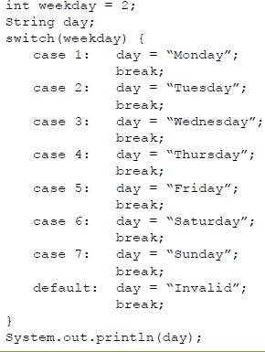
Switch statements
Switch statements are used when you want to ‘branch’ across possibilities and it would be aggravating to write 4+ statements – see the example on the right.
Unlike in loops, break is a necessary command here as, without it, all statements after the case would be counted as valid commands. For instance if (in case 1) there wasn’t a break command it would run it encountered a break command. In this example the following commands would run:
day = “Monday”;
day = “Tuesday”;
break;
And so you’d have the wrong day!
Note: when a String value is provided in the switch & case statements, it will be evaluated as if equals( ) was being used – as opposed to comparing the references of the two variables.

Slide 33
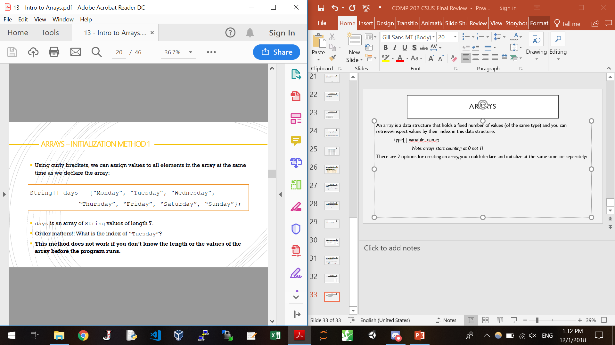
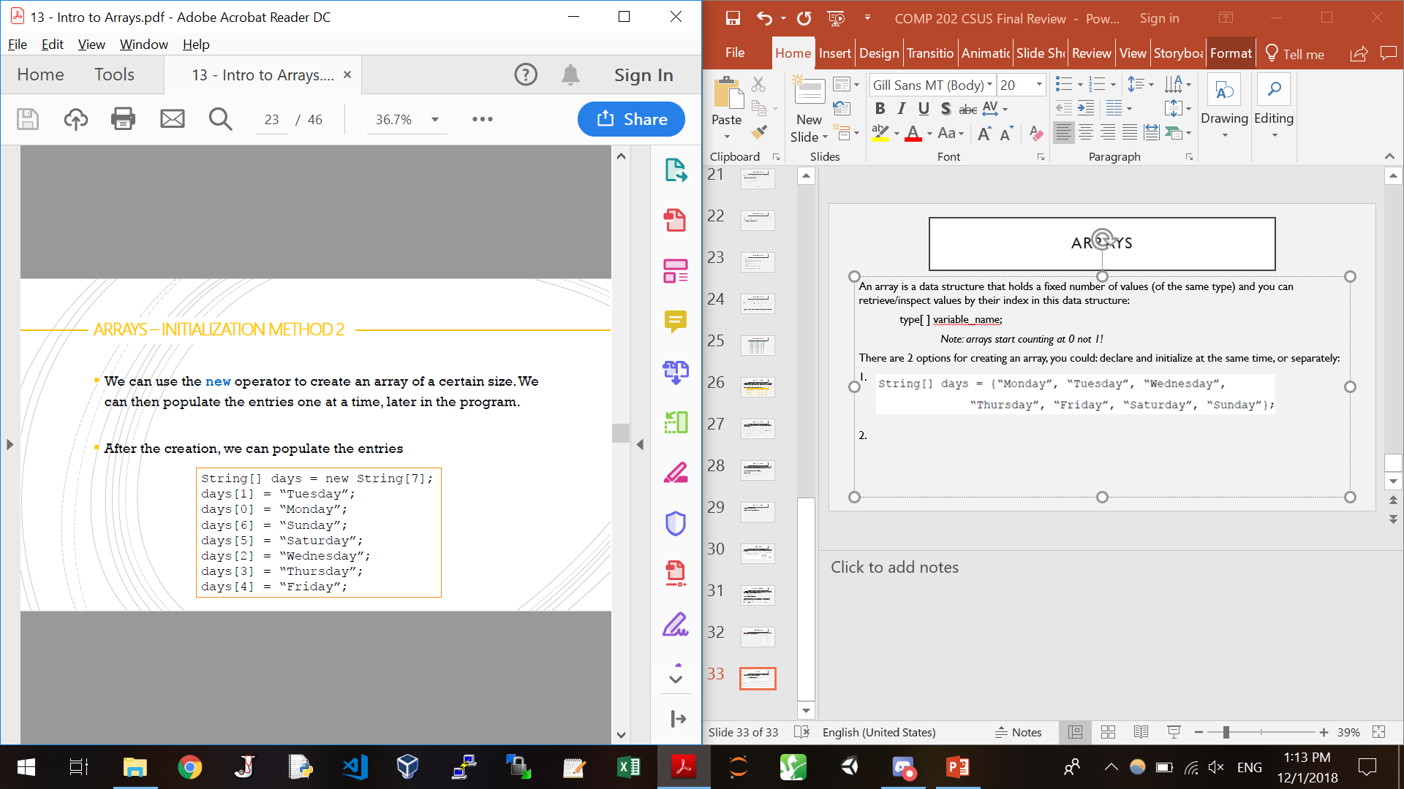
Arrays
An array is a data structure that holds a fixed number of values (of the same type) and you can retrieve/inspect values by their index in this data structure:
type[ ] variable_name;
Note: arrays start counting at 0 not 1!
To create an array, you could: declare and initialize at the same time, or separately (using new):
1.
2.

Slide 34
Arrays
Just like other data types in Java, arrays have default values – the default value is the same as that of the underlying data type. For instance, an int array will have default entry values of 0 while a String array will have default entry values of null.
Due to how this data structure works, its size cannot be changed after creation. Not only that but there are a few exceptions that can be thrown:
ArrayIndexOutOfBoundsException: thrown if you try to access an index outside of the valid range
NegativeArraySizeException: thrown if the size provided is negative
Note: you can use .length (on an array) to find out its length – this is because arrays keep track of their length internally

Slide 35
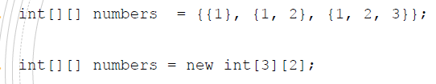
Arrays
You can also create multi-dimensional arrays (think grids) which allow you store an array as elements of another array i.e.
Because you are now comparing arrays of arrays, you won’t be able to use Arrays.equals, you’ll have to use Arrays.deepEquals( arr1, arr2 )!

Slide 36
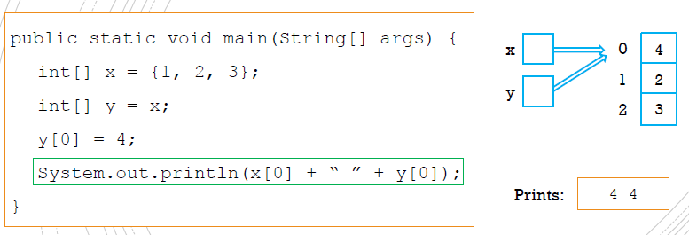
Reference Types
In Java, everything except the primitive data types is an Object which means that they don’t store the values of the objects they denote: they store a reference to the location in memory which contains the value. To make an analogy, a primitive data type (say an int) is like a box which has a number in it, while a reference type is a note which tells you where a box that holds (for instance) a number is.

Slide 37
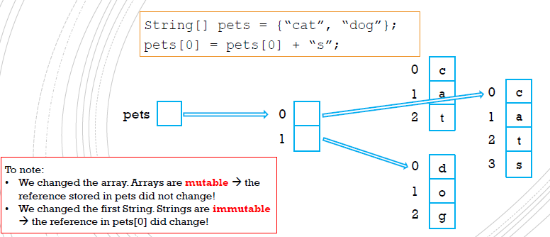
Reference Types
Reference objects, by default are given a null value – using the previous analogy, it would be as if the note was blank – and are either mutable or immutable: they can (or cannot) be changed. To see an example:
Note: if we try to follow a reference object that has a value of null, we’ll get a NullPointerException!
Notes:
I would go over this and explain the whole ‘follow pointers’

Slide 38
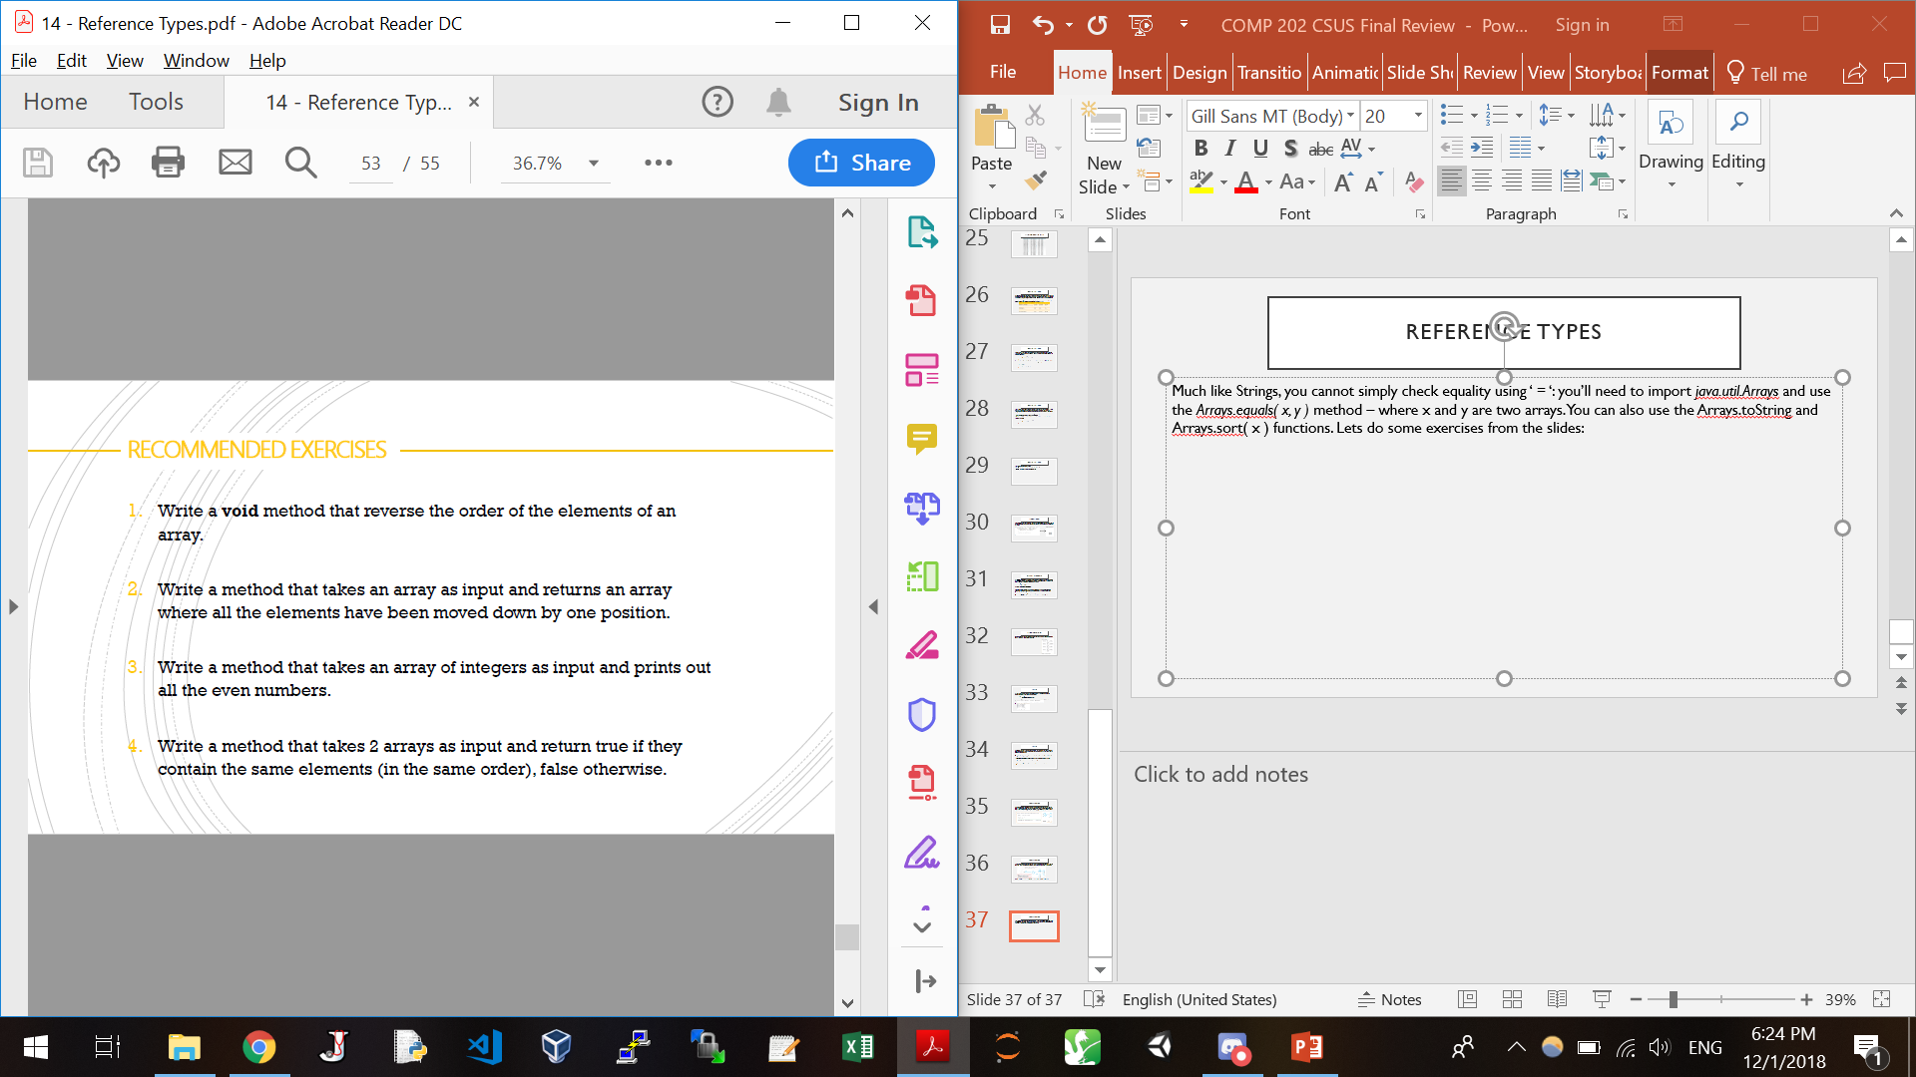
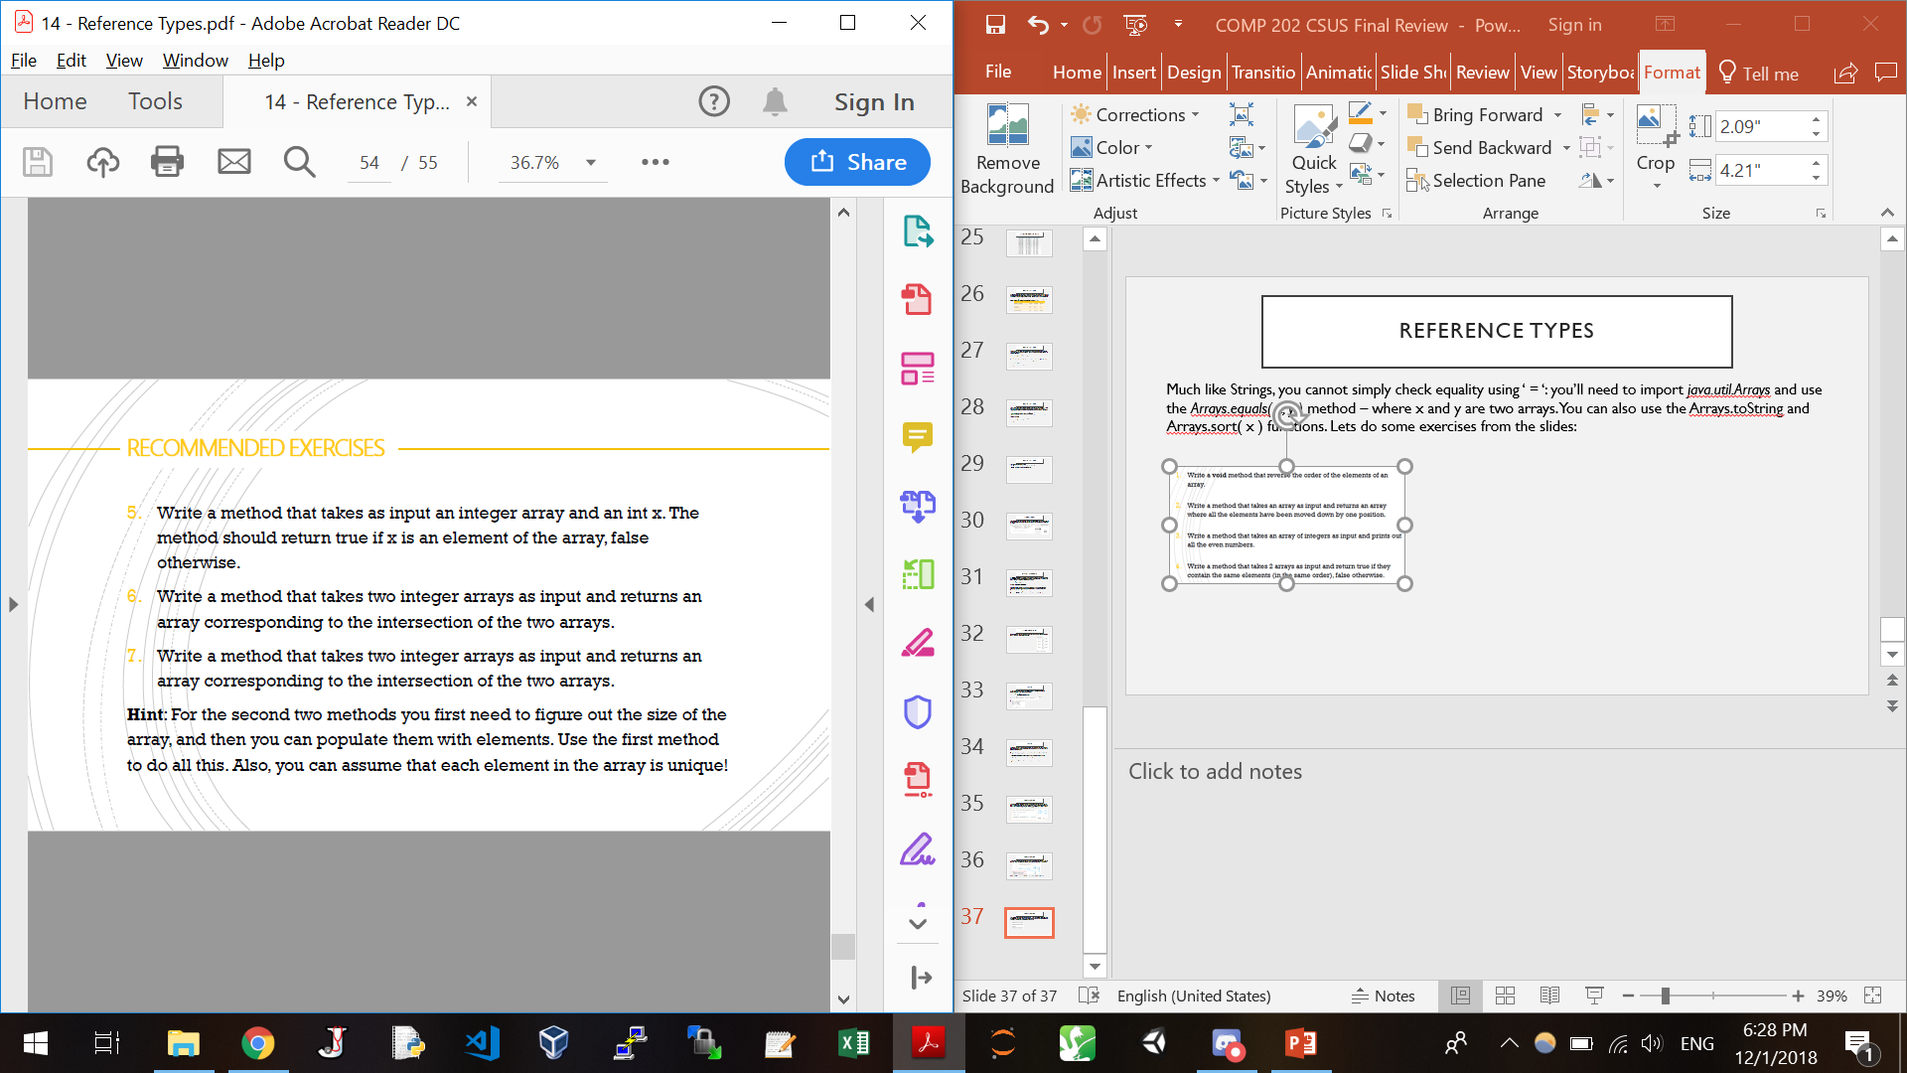
Reference Types
Much like Strings, you cannot simply check equality using ‘ = ‘: you’ll need to import java.util.Arrays and use the Arrays.equals( x, y ) method – where x and y are two arrays. You can also use the Arrays.toString and Arrays.sort( x ) functions. Lets do some exercises from the slides:

Slide 39
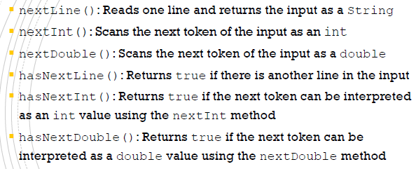
Scanner
Scanner is part of the java.util package and is incredibly useful for getting user input during runtime (i.e. while your program is running) – you use it by running the following command:
import java.util.Scanner;
If you want to create a Scanner object (to read input from the keyboard), you can do so by:
Scanner read = new Scanner( System.in )
Scanner has some super useful methods to parse its input:
Note: Scanner can throw up an InputMismatchException if it incorrectly tries to read a certain type of information (from a Scanner object) – i.e. expects an int but finds a String.

Slide 40
Random
We covered math.random( ) before but you can use the Random class to, very specifically, generate random numbers by choosing the seed for the random number generator (RNG). This can be particularly useful as it’ll allow you to control the randomness, you’ll even see the same sequence of random numbers! Again you’ll need to import it but then you could run the following:
import java.util.Random;
…
Random randomGenerator = new Random( ); // Use this if you just want a RNG
Random otherGenerator – new Random( seed ); // Use this if you want a seed

Slide 41
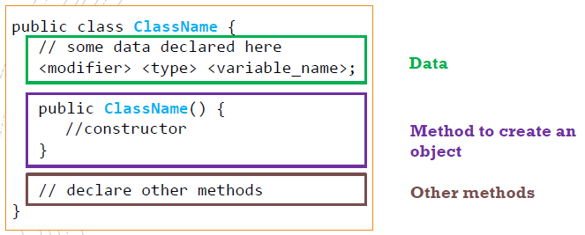
Objects
As you’ve learned in class, a Java class can be thought of as a template that defines what type of information we want to package together (attributes) and what we want to be able to do with it (methods); a particular instance of a class is an Object. Because Java is an Object Oriented language it uses Objects to represent and manipulate data.
More than this, we can define our own classes! Generally it’ll follow this structure:

Slide 42
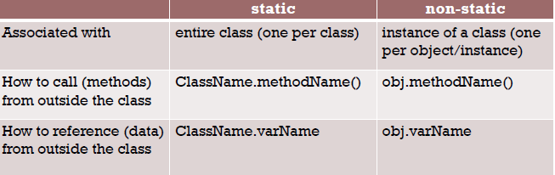
Objects
The variables that denote the data stored by an object are called attributes (or fields depending on context). These are declared at the very beginning of the class definition with the following syntax:
<modifier> <type> <variable_name>;
Note that modifiers are keywords that you add to definitions to change their meaning such as private/public, static and final. The distinction between public and private is very important as it affects how other developers can access – a crucial security aspect!
As for static:

Slide 43
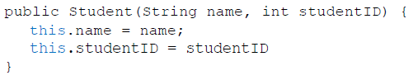
Objects
Constructors are special methods, called at the conception of an Object – they have no return type and are non-static. They must have the same name as the class; the general syntax is:
public ClassName( <parameters> ) {
// Code
}
Another important concept in Object Oriented Programming (OOP) is the keyword this. It refers to the Object on which methods are being called. For instance, in a constructor, it refers to the Object that is being constructed, e.g.
Note: because static methods are associated to the entire class, it doesn’t make sense to use this!

Slide 44
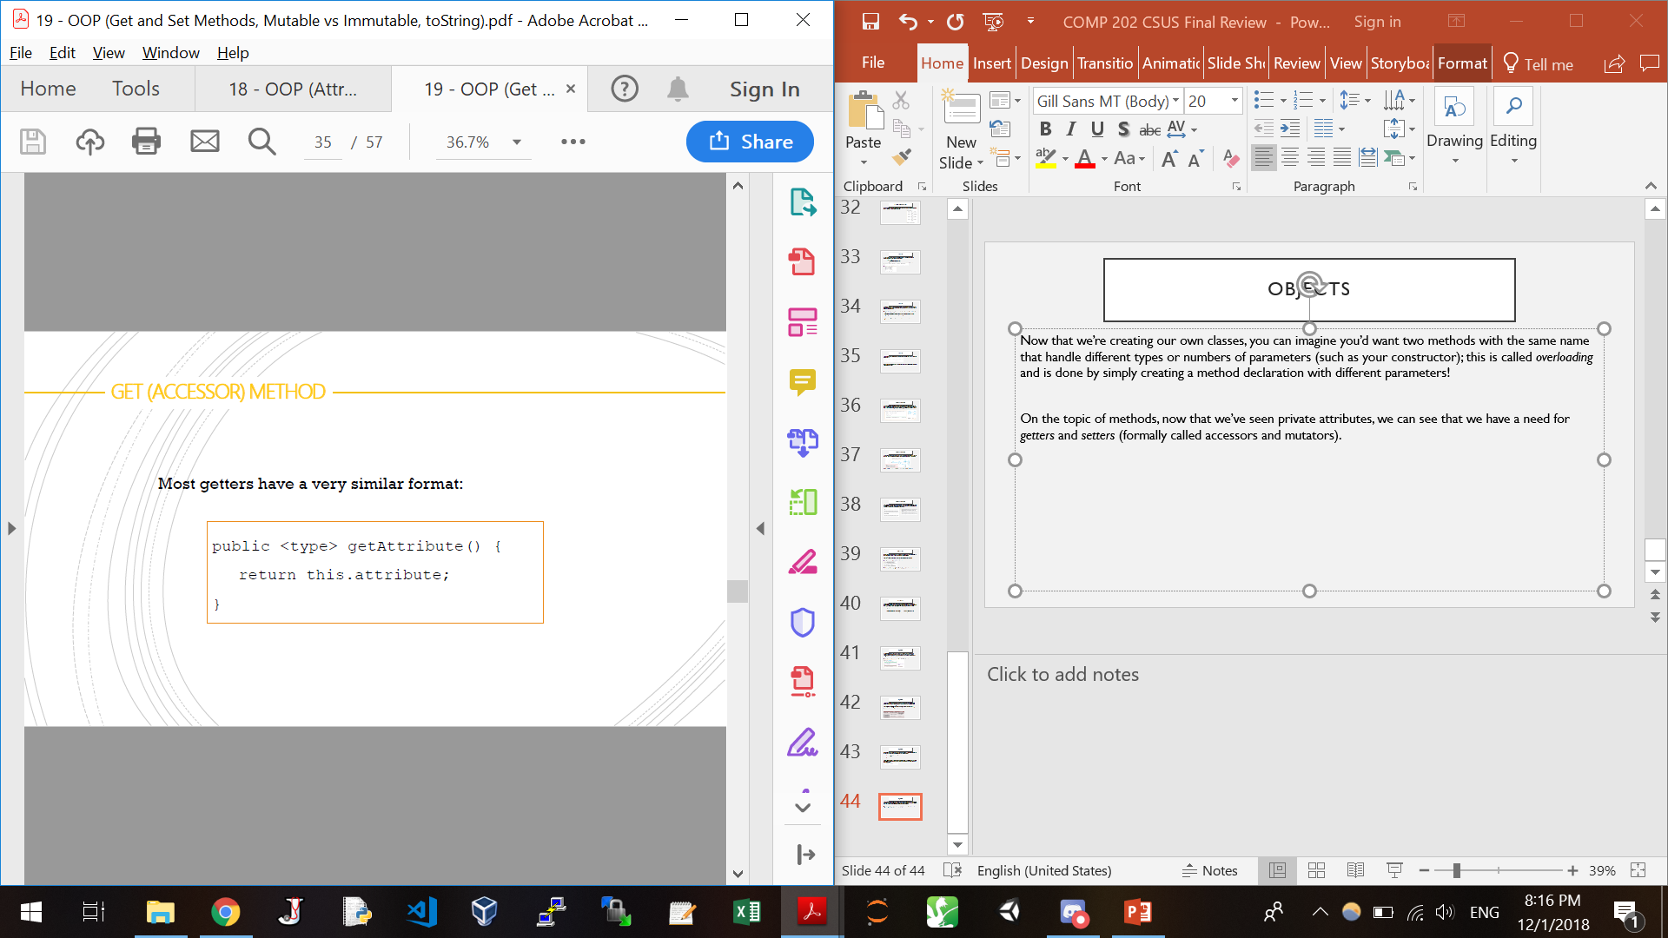
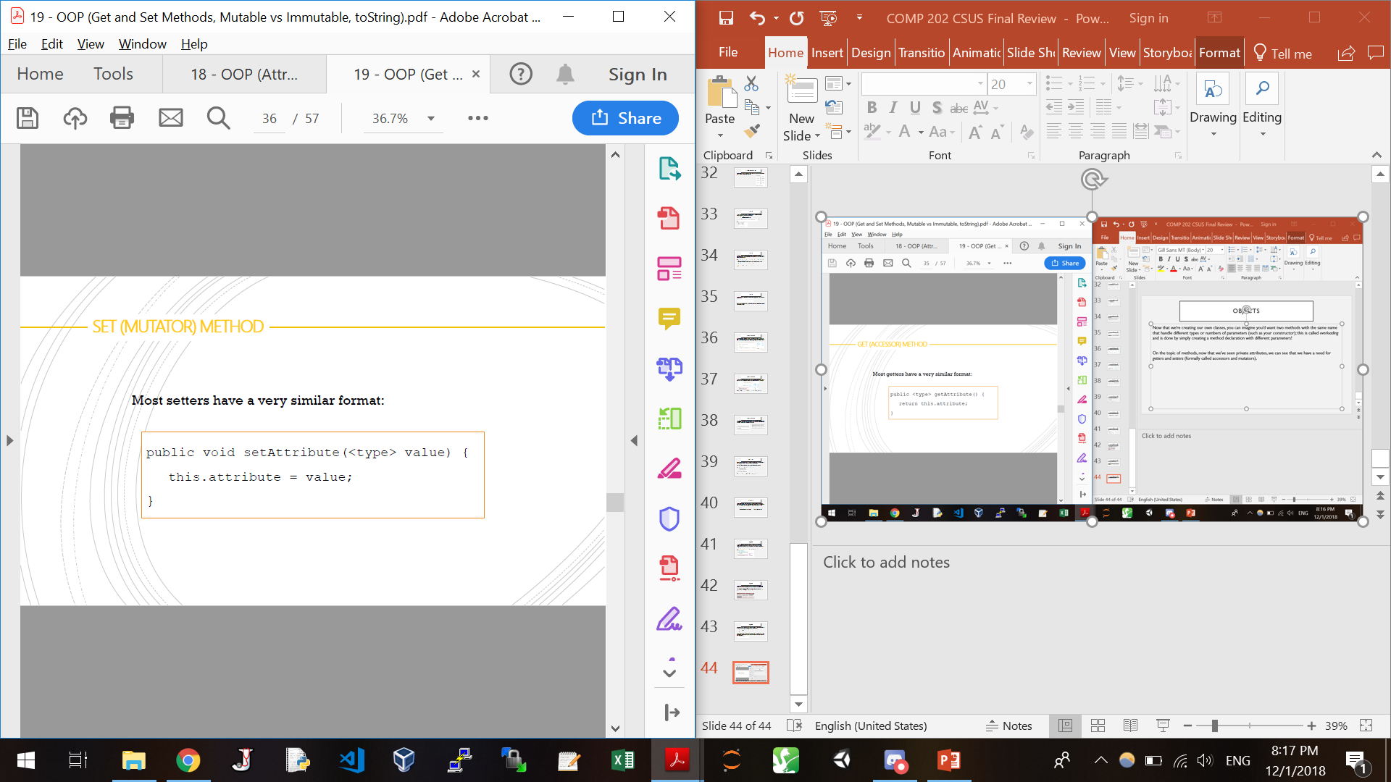
Objects
Now that we’re creating our own classes, you can imagine you’d want two methods with the same name that handle different types or numbers of parameters (such as your constructor); this is called overloading and is done by simply creating a method declaration with different parameters!
On the topic of methods, now that we’ve seen private attributes, we can see that we have a need for getters and setters (formally called accessors and mutators) with the following syntax, respectively:
Notes:
Lectures 20 & 21 have some good OOP examples!

Slide 45
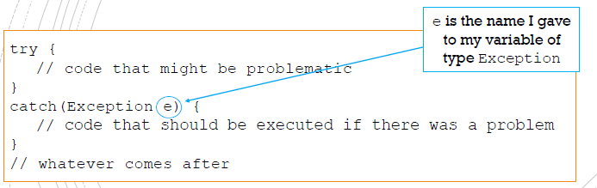
Exceptions (contd.)
If you want to throw (i.e. create) a new exception you do so with the following syntax:
throw new <name_of_exception> (message); note: message is an optional String
But we can also catch exceptions: we can divert the control flow to circumvent an exception and have our own code be executed with the following syntax:
Note: there’s an additional block you can add: finally. The finally block always executes – even when there’s a return statement (or something similar)
e is a super useful as it can show us all the errors with:
e.printStackTrace();

Slide 46
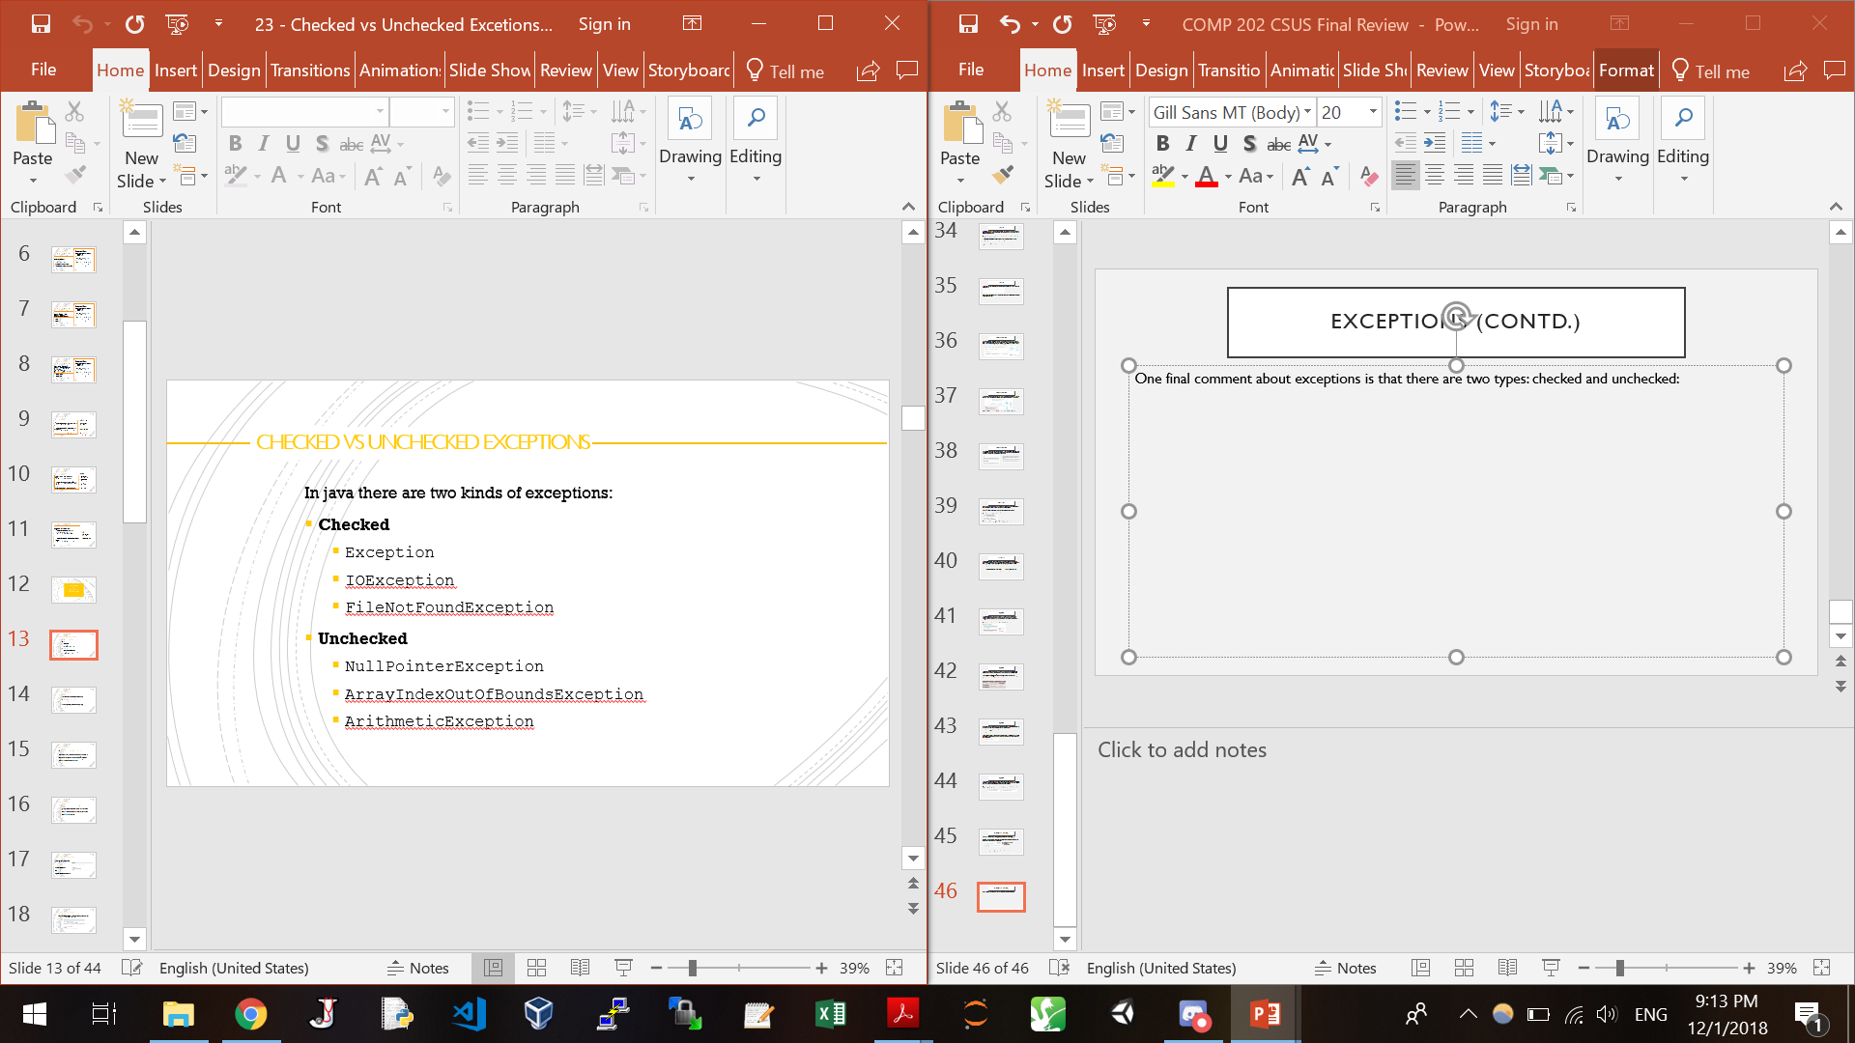
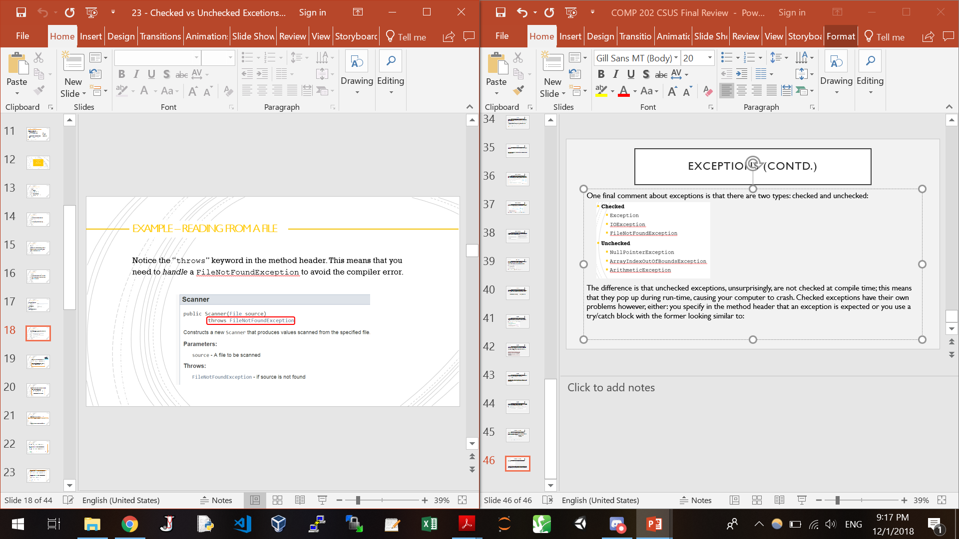
Exceptions (contd.)
One final comment about exceptions is that there are two types: checked and unchecked:
The difference is that unchecked exceptions, unsurprisingly, are not checked at compile time; this means that they pop up during run-time, causing your computer to crash. Checked exceptions have their own problems however, either: you specify in the method header that an exception is expected or you use a try/catch block with the former looking similar to:

Slide 47
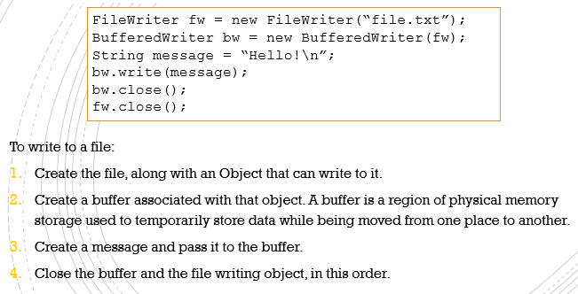
FILE i/o
Similarly to other functions and methods we’ve seen so far that handle input from outside your code (such as Scanners), there are Objects that allow you to manipulate and interact with files; these operations are called file I/O (aka input/output). Note: because of the inherent complexity with I/O, you’ll need to handle the (checked) exception IOException and include:
import java.io.*;
In Java, the standard form for writing to a file is, to take an example from your slides:

Slide 48
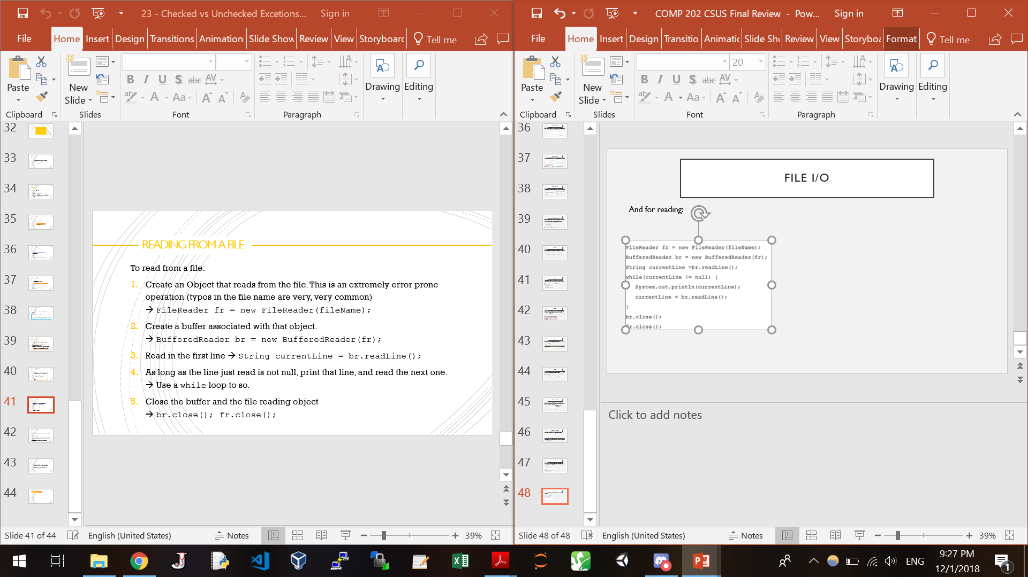
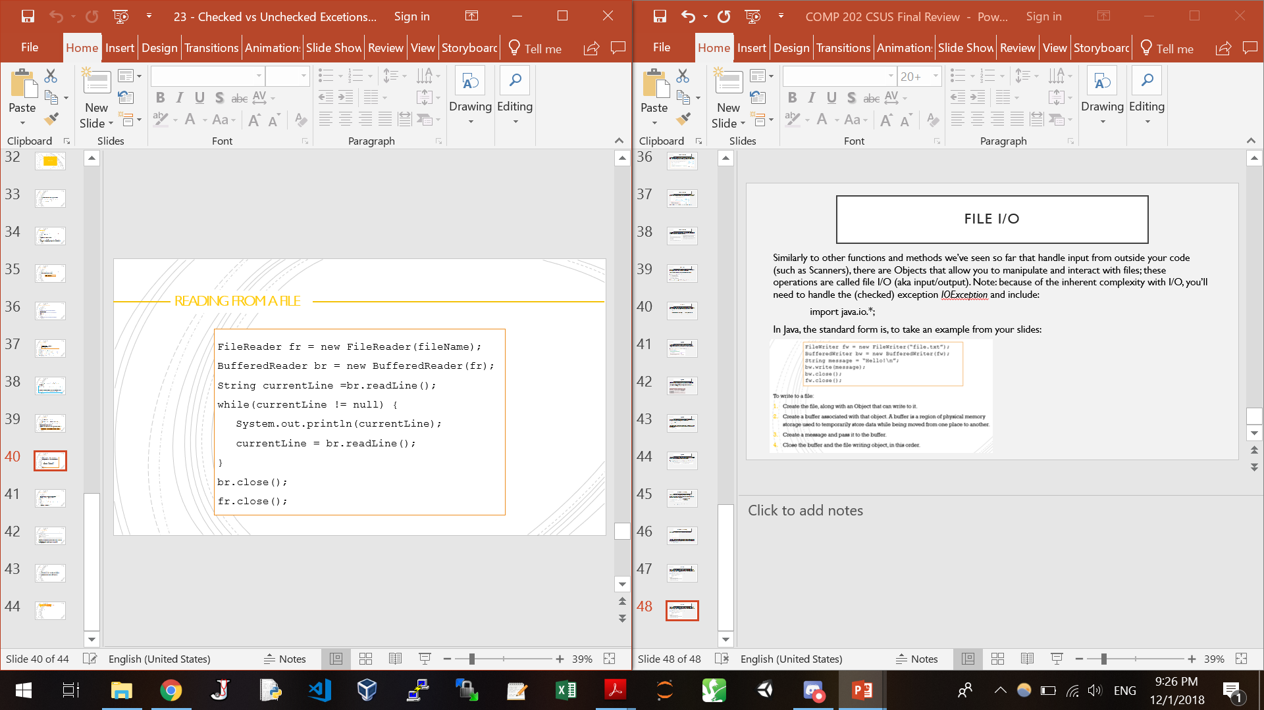
FILE i/o
And for reading:

Slide 49
Arraylist
Another data structure (other than Array or a custom/specific class) is an Arraylist. Unlike Arrays, Arraylists are a dynamic data structure: they can grow and shrink to fit the needs of the program (during run-time!) To use Arraylists you’ll need to include:
import java.util.ArrayList;
And the syntax for usage is:
ArrayList<type> varName = new ArraList<type>( );
We’ll look at some useful methods on the next page:

Slide 50
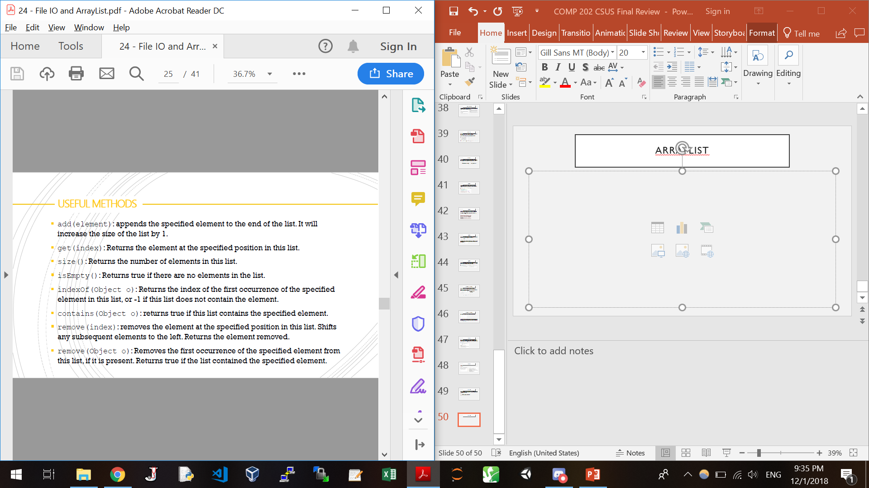
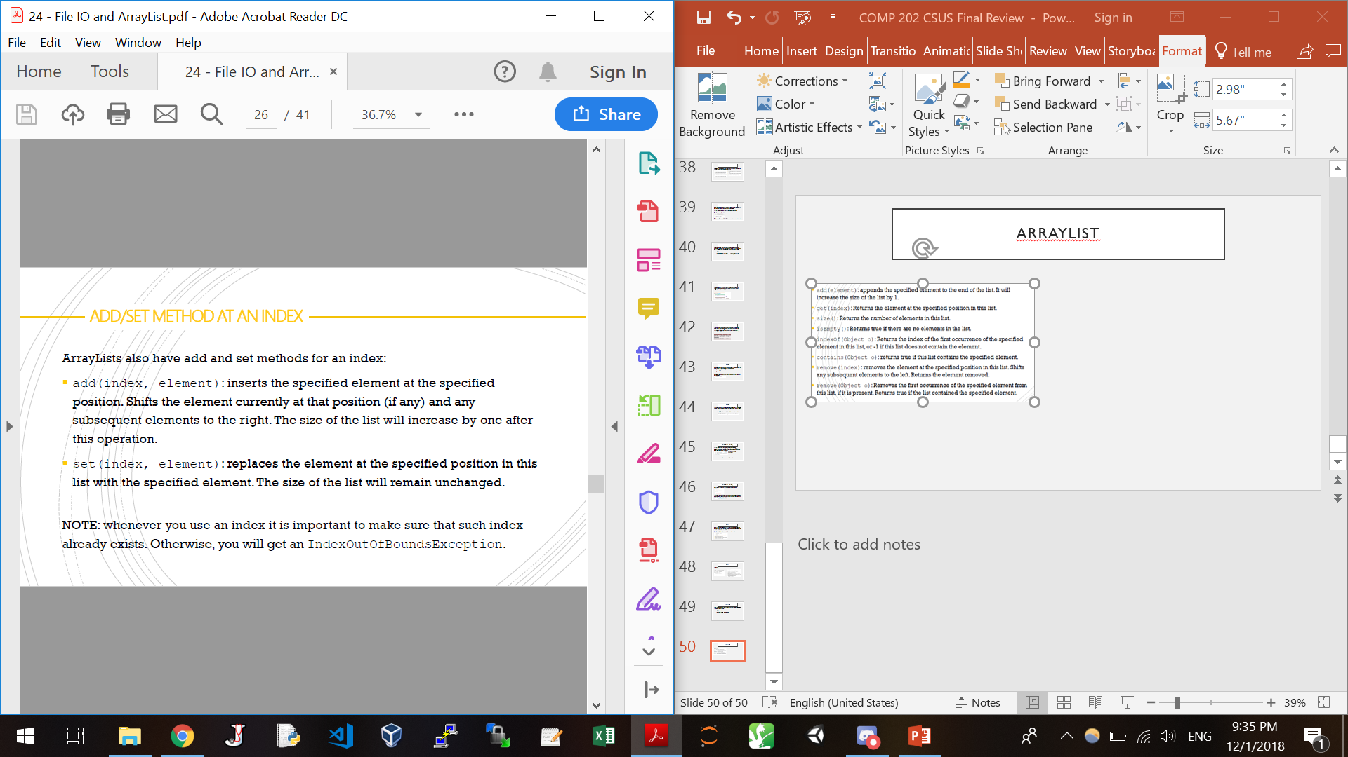
Arraylist

